Slide 1
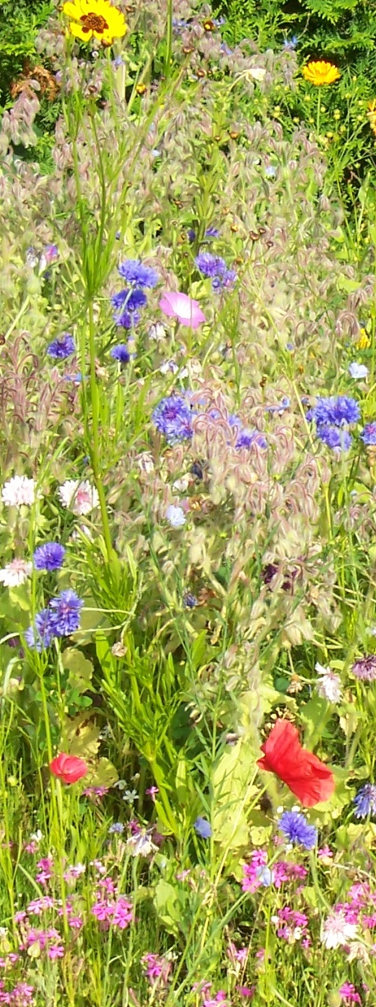
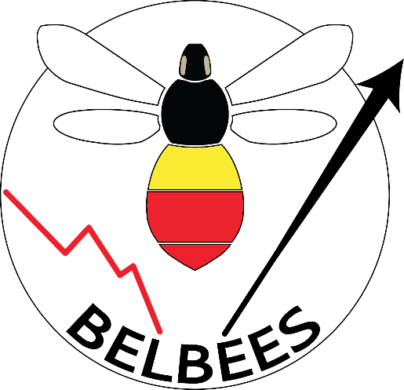









Etat des lieux et tendances des abeilles sauvages en Belgique
Colloque - Qui fait quoi pour les abeilles ?
Session Recherche
BELBEES project
BELSPO – BRAIN-be
15th of May 2017

Slide 2

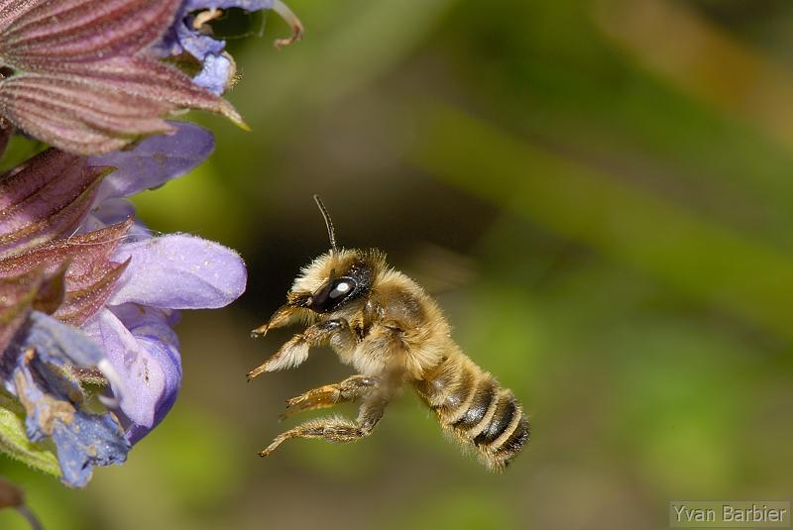
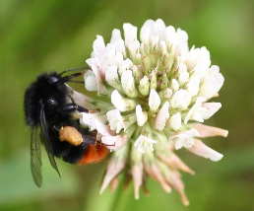
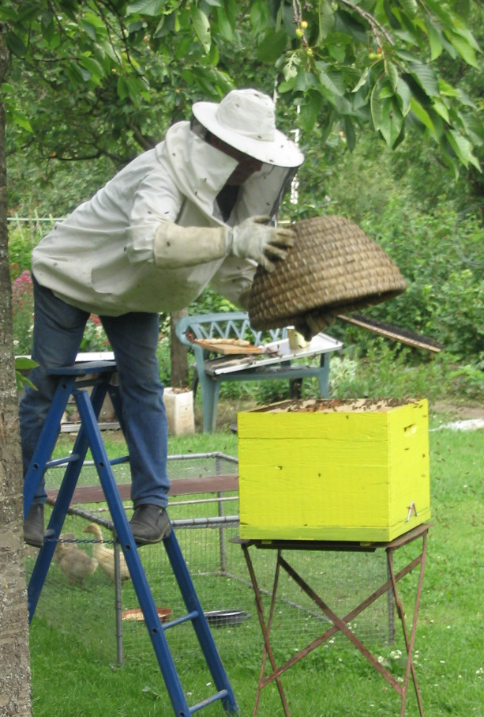
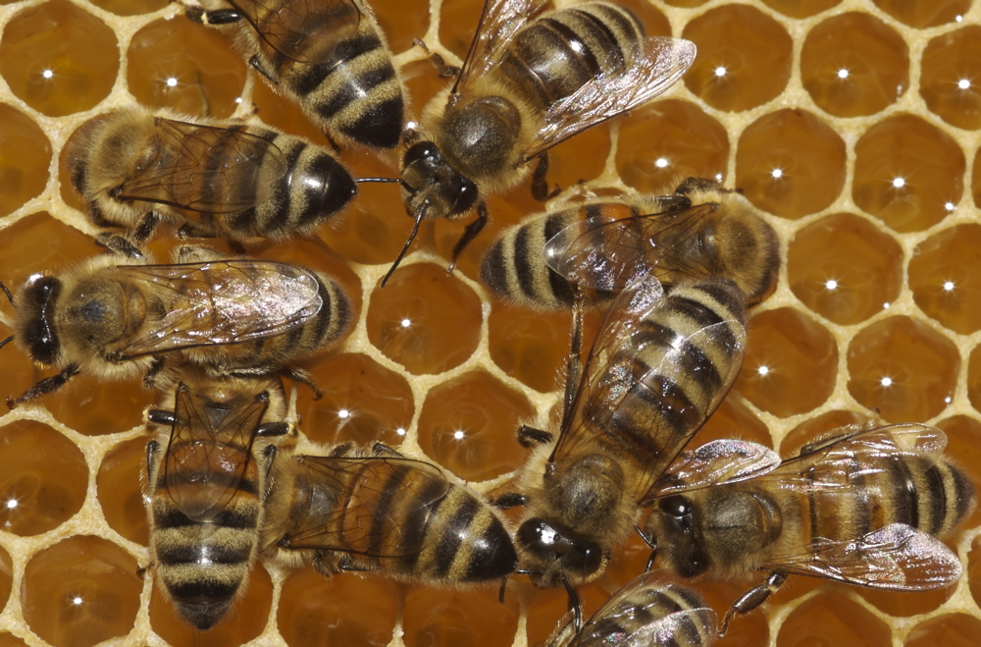
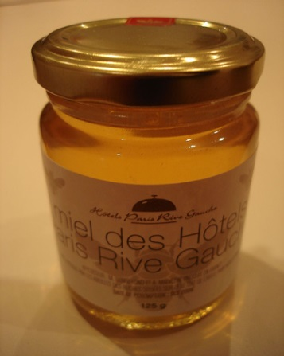

Context
More than Honey bee (Apis mellifera)…
Nicolas Vereecken

Slide 3
Context
Bees = ~20.000 species in the world; 6 families, 47 genera, 1965 species of wild bees in Europe !

Slide 4
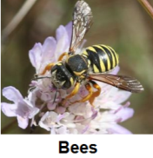
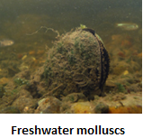
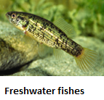
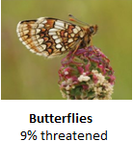
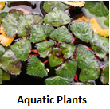
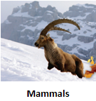
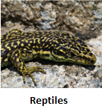
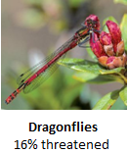
IUCN comprehensive studies in Europe
1965
854
524
Huge relative species diversity of bees in Europe !
393
393
228
151
137

Slide 5
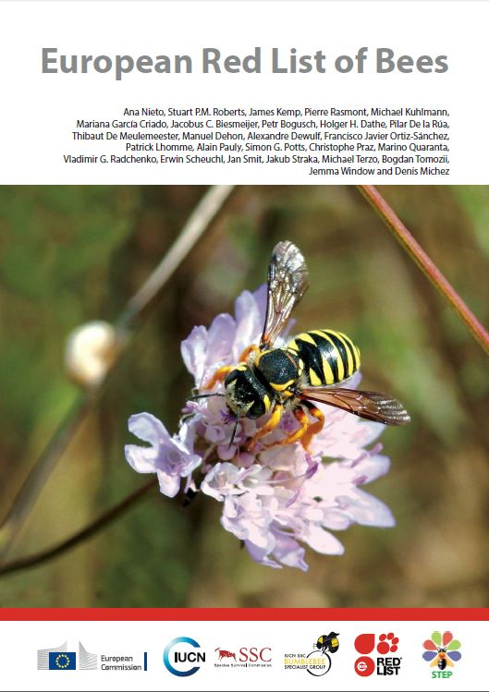



Collaborative effort by:
Context
Nieto et al. 2014

Slide 6
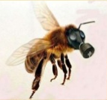
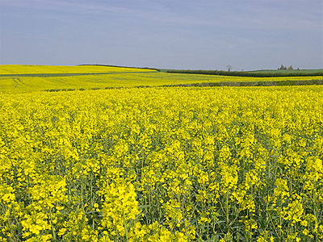
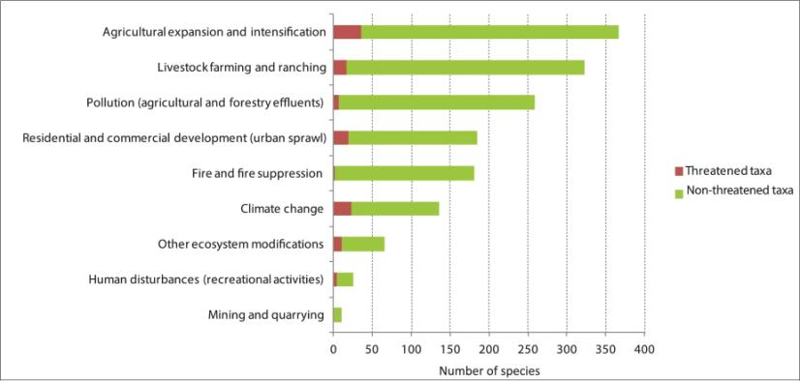
Context
Main results of STEP project
and European Red List

Slide 7
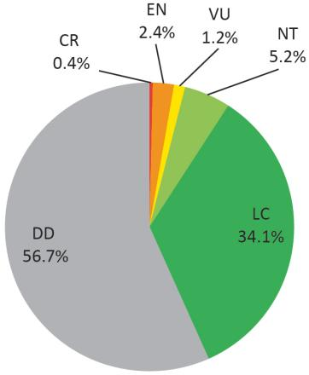
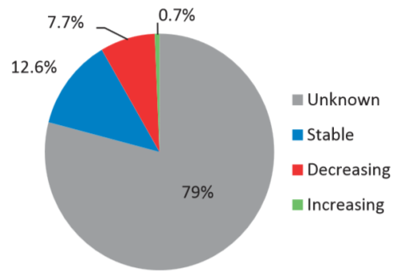
Context
BUT huge gap of data….

Slide 8
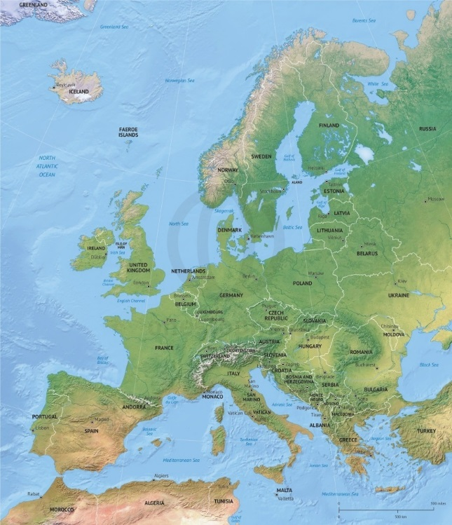
Context
What about the status and trends of wild bees in Belgium?

Slide 9
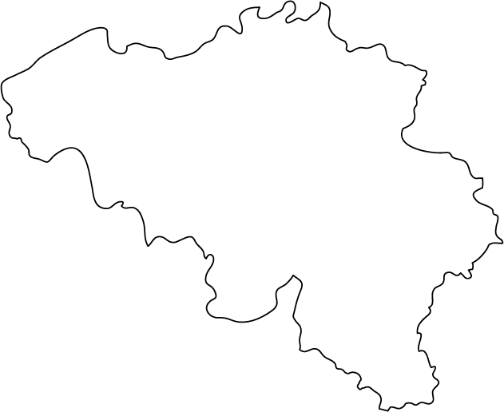
Team of BELBEES
We made a team with expertise!
Notes:
We encoded more than 62 thousands bumblebee specimens from the Ball’s collection.
This represents 29 species.
97 percents of the specimens are from the period nineteen-ten to nineteen-thirty.

Slide 10
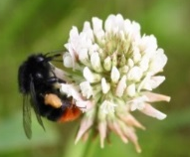






the BELBEES project
Species distribution
1870 - 2015
Floral resource
Land-use change
Pesticide exposure
Disease emergence
Genetic pauperization
Modeling
Climate change

Slide 11
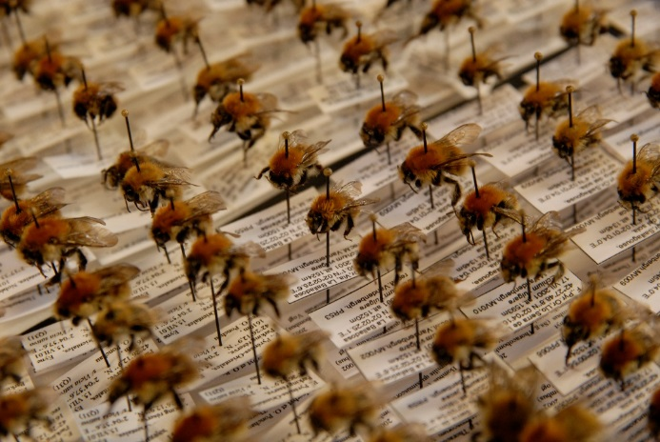
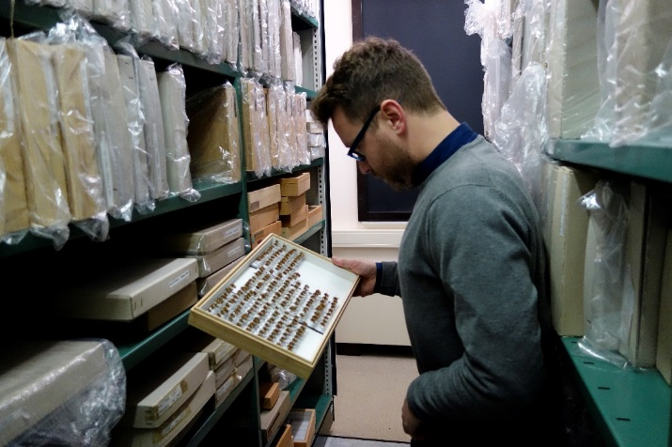
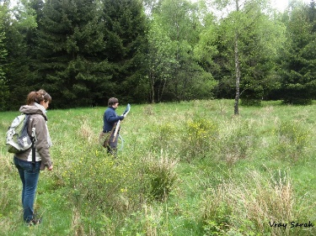
Goals of BELBEES
WP 2. | Population trends [UMONS, RBINS]
HOW?
Populations
Number of species
Increase
Stable
Decrease
19th century
20th century
21th century
Present time

Slide 12
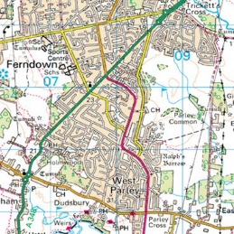
Goals of BELBEES
WP 3. | Hypothesis testing [All partners]
WP 4. | Meta-analysis and modelling [UNamur, ULg]
WHY?
Populations
Number of species
Increase
Stable
Decrease
Food depletion
Habitat loss
Parasite
spill-over
Pesticide
Climate change

Slide 13
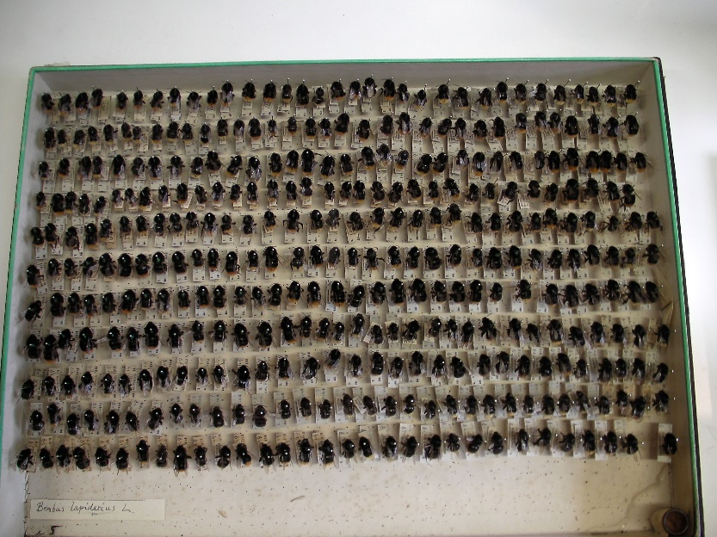
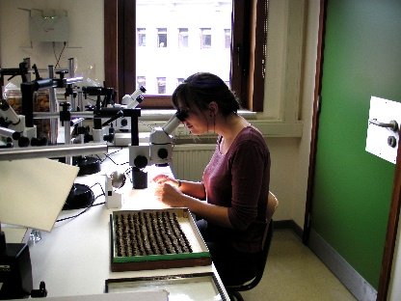
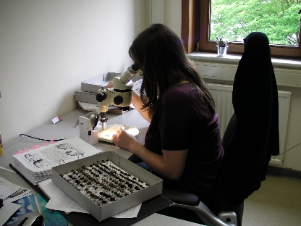
WP2. Population trends
Task 1. Digitization of museum collections.
Bumblebees of the Ball’s collection (RBINS)
62 784 specimens - 29 species - 97% in 1910-1930
Notes:
We encoded more than 62 thousands bumblebee specimens from the Ball’s collection.
This represents 29 species.
97 percents of the specimens are from the period nineteen-ten to nineteen-thirty.

Slide 14
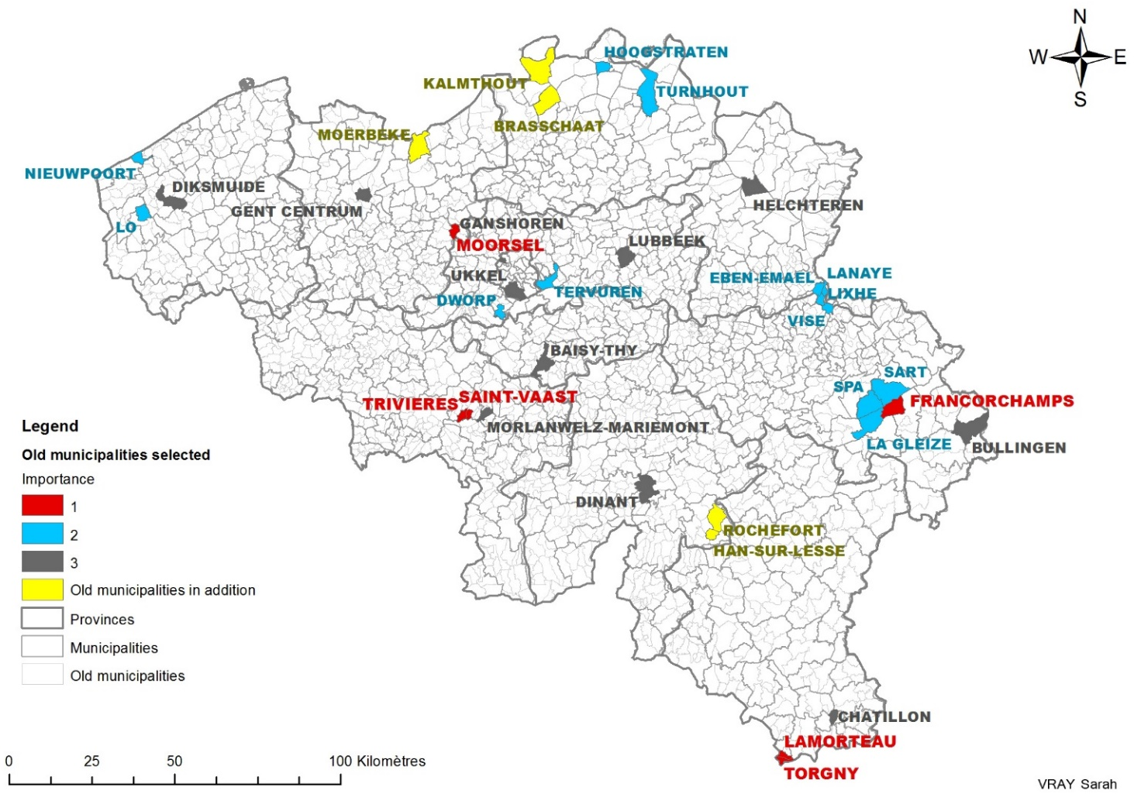
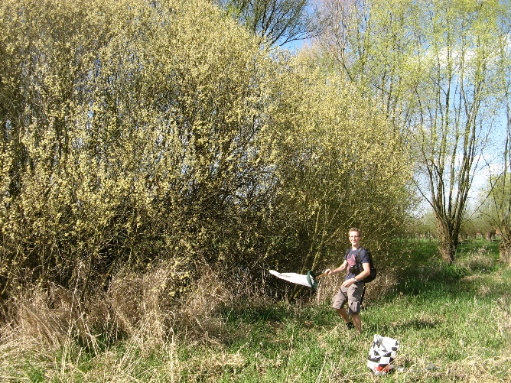
WP2. Population trends
Task 5. Collection of new samples
3806 specimens – 19 species
Collected in 10 target localities around Belgium.

Slide 15
WP2. Population trends
Bumblebees : past vs. present.
In 100 years, 9 bumblebee species disappeared in Belgium.
Species richness felt in ¾ of the localities, but remained quite similar in Torgny & Lamorteau.
Notes:
If we compare these results with those of a hundred years ago, we see that 9 species have disappeared in Belgium.
Species richness decreased for 3 of the 4 localities, except for Lamorteau and Torgny where it remained quite similar.

Slide 16
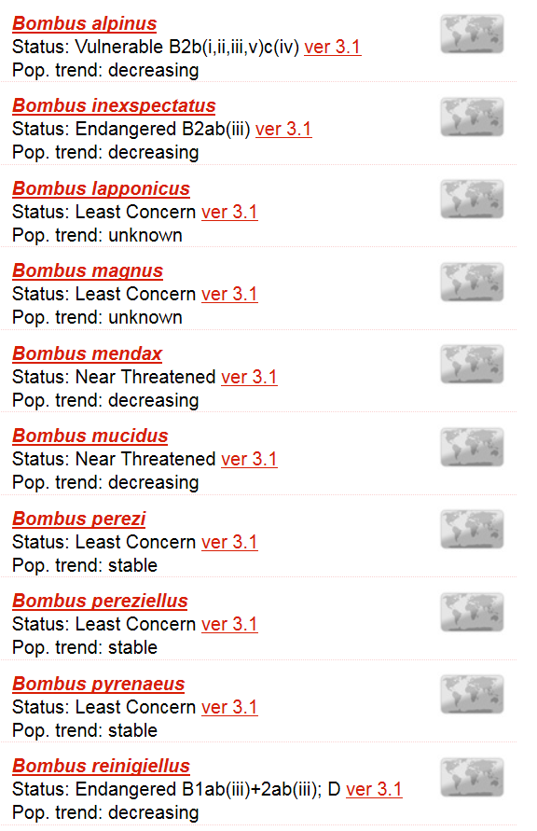

WP2. Population trends
Task 6. Trend analyses and Belgian IUCN Red List.
Europe:
Rasmont P., Roberts S., Cederberg B., Radchenko V. & Michez D. 2015. Bombus. The IUCN Red List of Threatened Species. Version 2015.3. <www.iucnredlist.org>.
Belgium: in preparation.

Slide 17

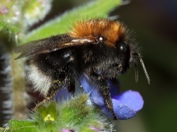
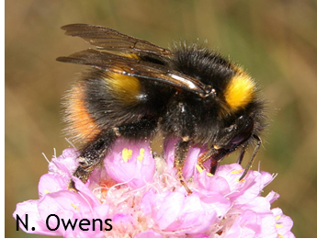
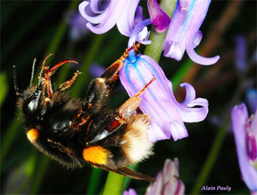
WP3. Hypothesis testing
1. Floral choices
Task 3.1. Interspecific variation of host-plant ressources
Moerman et al. (2017)
Bombus terrestris needs six times less pollen to make same mass of larva
Best performance on different diet according to Bombus species

Slide 18
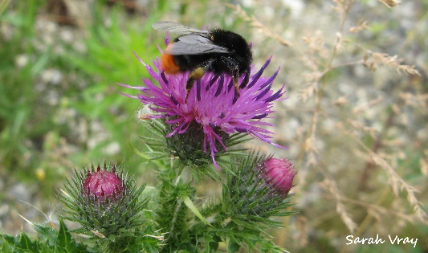
WP3. Hypothesis testing
1. Floral choices
Endangered by laws: potential consequences of regulations against thistles on bumblebee conservation
Sarah Vray, Thomas Lecocq, Stuart P.M. Roberts, Pierre Rasmont
Some European countries apply strict regulations against thistles (weeds in agricultural landscapes)
But our results show that most of floral visit of males occur on thistles and some species are almost exclusively observed on them
Thistle removal is thus most likely a threat for bumblebees

Slide 19
WP3. Hypothesis testing
2. Genetics and inbreeding
Task 3.2. Occurrence of genetic bottlenecks, changes in gene flow and genetic diversity?
4 restricted and 4 widespread species
No lost of genetic diversity
Differences in global genetic diversity

Slide 20
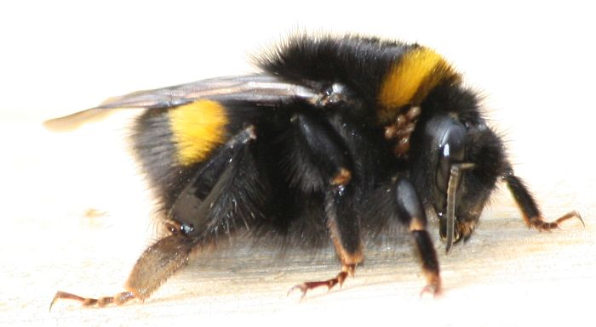
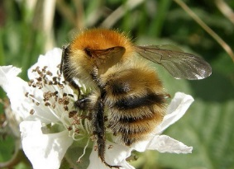
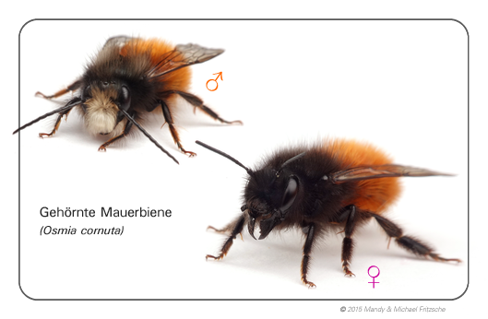
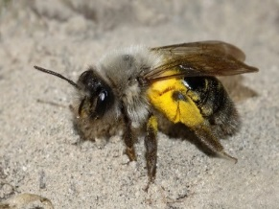
WP3. Hypothesis testing
3. Parasite emergence
Task 3.3. Occurrence of parasite in wild bees of Belgium?
Many pathogens are shared among wild bees
Virus have a broader range of hosts
Biological roles still have to be explored

Slide 21



WP3. Hypothesis testing
5. Climate change
Climate change impacts on bumblebees converge across continents
J. T. Kerr, A. Pindar, P. Galpern, L. Packer, S. G. Potts, S. M. Roberts, P. Rasmont, O. Schweiger, S. R. Colla, L. L. Richardson, D. L. Wagner, L. F. Gall, D. S. Sikes, A. Pantoja.
Long-term observations across Europe
and North America over 110 years.
Found cross-continentally consistent trends in :
failures to track warming through time at species’ northern range limits
range losses from southern range limits
shifts to higher elevations among southern species

Slide 22
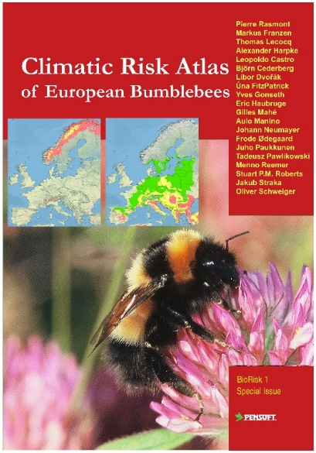
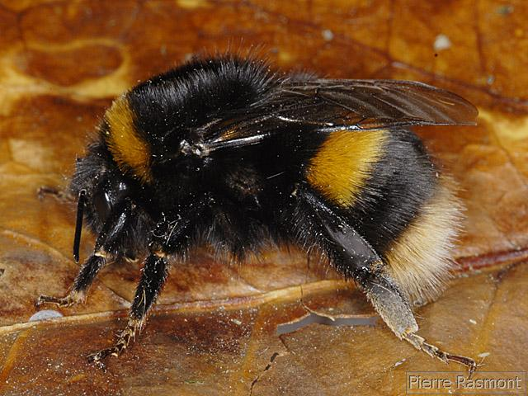
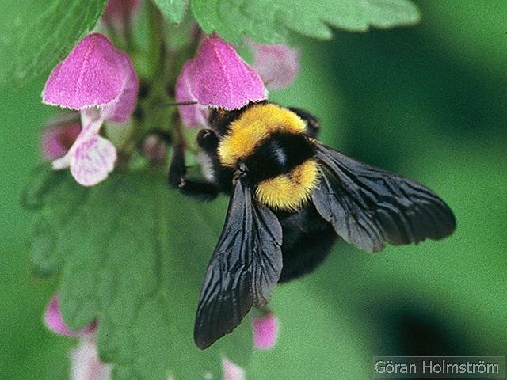
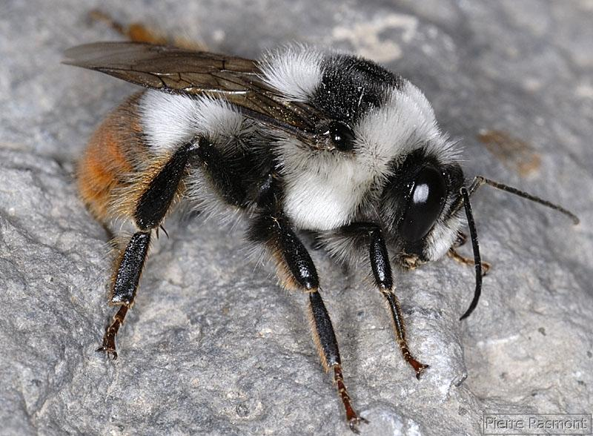
WP3. Hypothesis testing
5. Climate change
Climatic Risk Atlas of European Bumblebees
What about Belgium?
3 species left in 2100 in the worst scenario (GRAS)
Bombus terrestris | Bombus argillaceus | Bombus niveatus

Slide 23
BELBEES Project
 | TAKE HOME MESSAGES
 | Many species experienced during the 20th century and are still experiencing now (e.g. Bombus) a strong decline of their populations… to the extinction for some of them Some species are rediscovered thanks to intense monitoring The main threats are probably associated to intense agricultural practices and climate change We can change the policy to make Belgium more wild bee friendly

Slide 24
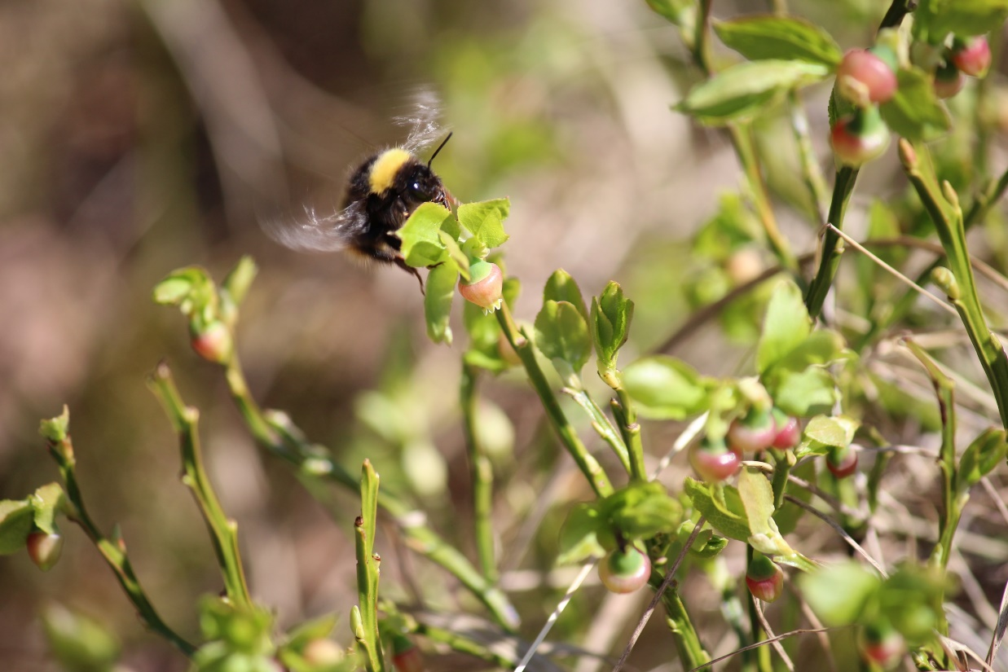
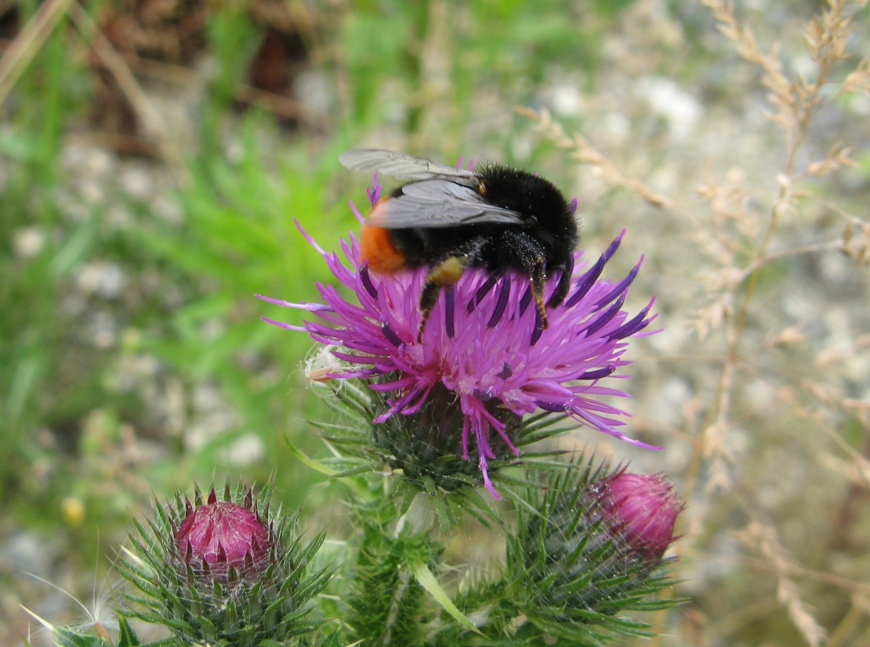
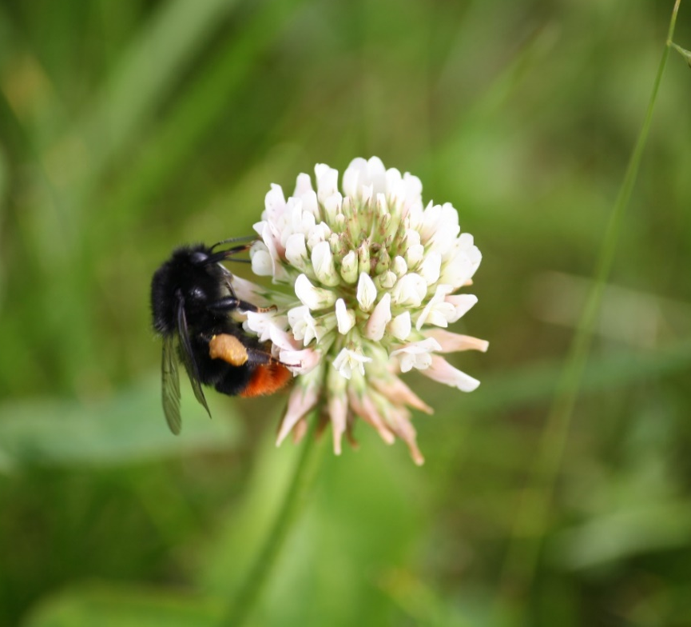
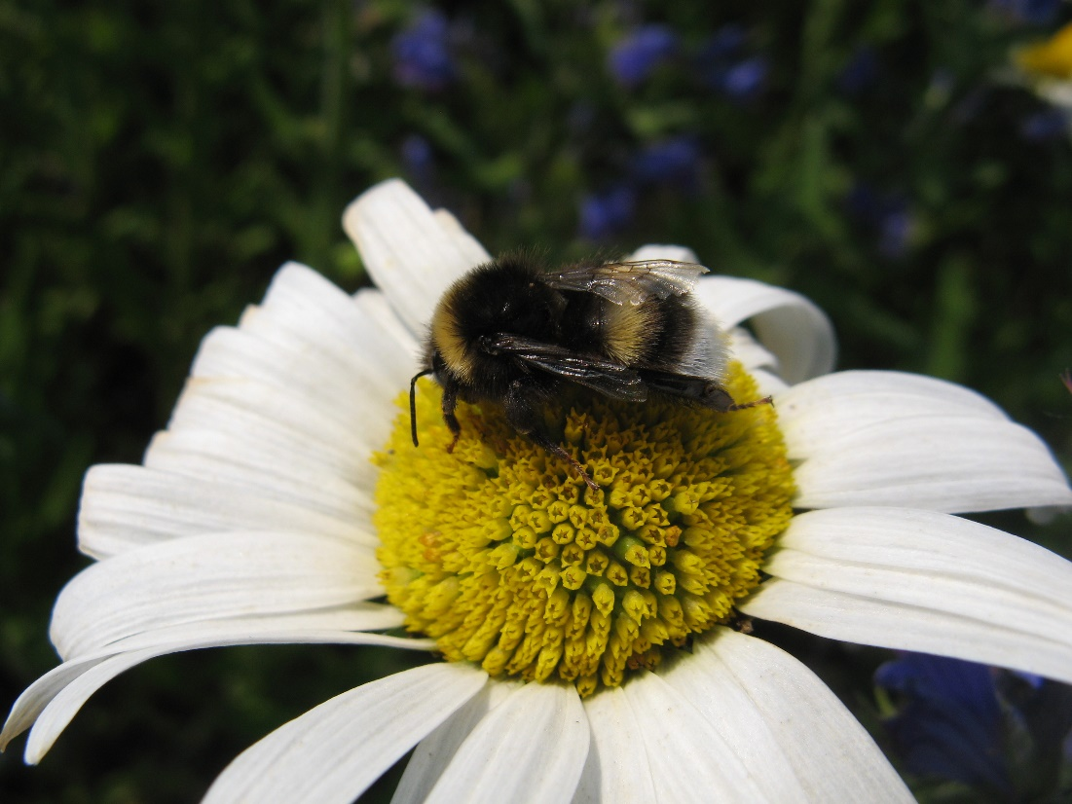

Thank you for your attention !

Slide 25





Communication
Website:
www.belbees.be
(FR, NL, EN)
Denis.michez@umons.ac.be
Facebook:
Twitter:

